Slide 1
Machine Learning With R
Bella Feng
OCRUG 11/30/2017

Slide 2
Agenda
Introduction to Machine Learning
Machine learning project workflow
Commonly-seen ML algorithms
A small ML project on Spam detection using R

Slide 3
What is Machine Learning?
Arthur Samuel: machine learning is the field of study that gives computers the ability to learn without being explicitly programmed.
Tom M. Mitchell: A computer program is said to learn from experience E with respect to some class of tasks T and performance measure P, if its performance at tasks in T, as measured by P, improves with experience E.

Slide 4
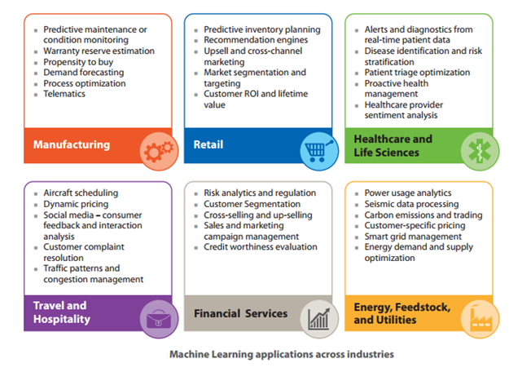
What are the use cases?
Better Medicine Through Machine Learning | Suchi Saria | TEDxBoston

Slide 5
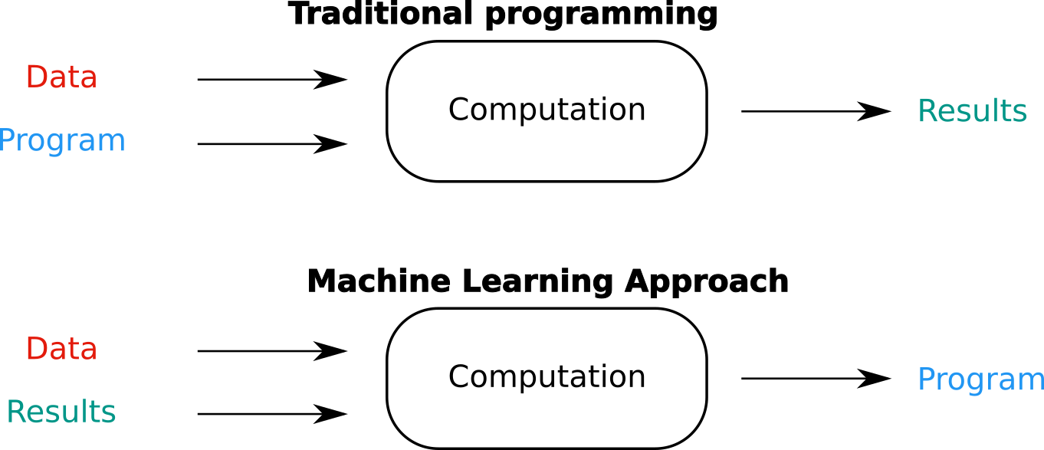
Traditional programming vs. ML approach

Slide 6
Workflow of a data science project
Step 1: Collecting data/Define the Problem
Step 2: Exploring and preparing the data
Step 3: Training/Spot Check Algorithms
Step 4: Evaluating model performance
Step 5: Improving model performance

Slide 7
Step 1: Define the Problem
1) what do we want to do?
Regression/classification/clustering?
2) what is available?
How much data do you have?
3) what are my constraints?
What is your data storage capacity?
Do you need the learning to be fast?
Do you need the prediction to be fast?
Maintainability
Communication

Slide 8
Step 2: Exploring and preparing the data
summarizing the attributes
visualizing them using scatter plots and histograms.
describe in detail each attribute and relationships between attributes.
Step 1: Data Selection: Consider
what data is available,
what data is missing
what data can be removed.
Step 2: Data Preprocessing:
Organize your selected data by formatting, cleaning and sampling from it.
Step 3: Data Transformation: scaling and standardization, etc.

Slide 9
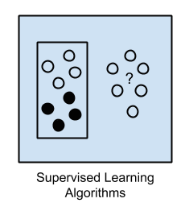
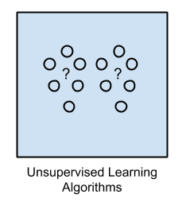
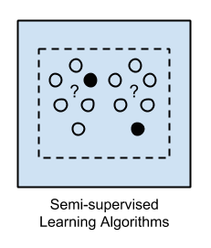
Step 3: Training/Spot Check Algorithms
Supervised Learning
Unsupervised Learning
Semi-supervised Learning

Slide 10
Supervised Learning
KNN
Classification
Naïve Bayes
SVM
Decision Trees
Supervised Learning
Classification Rule Learners
Linear Regression
Numeric Prediction
NN
Regression Trees
Model Trees

Slide 11
Unsupervised Learning
Association rules
Unsupervised Learning
K-means clustering

Slide 12
Pros and Cons of various algorithms
Algorithm | Type | Tolerance number features | Parametrization | Memory Size | Required data size | Communication | Overfitting Tendency | Difficulty | Time for learning | Time for predicting
Linear Regression | R | Weak | Simple | Small | Small | ++ | Low | Weak | Weak | Weak
Logistic Regression | C | Weak | Simple | Small | Small | ++ | Low | Weak | Weak | Weak
Decision Tree | R&C | Strong | Simple/intuitive | Large | Small | +++ | Very high | Weak | Weak | Weak
Random Forest | R&C | Strong | Simple/intuitive | Very Large | Large | ++ | Average | Average | Costly | Costly
Boosting | R&C | Strong | Simple/intuitive | Very Large | Large | + | Average | Average | Costly | Weak
Naive Bayes | C | Weak | NO PARAMs | Small | Small | ++ | Low | Weak | Week | Weak
SVM | C | Very strong | Not intuitive | Small | Large | -- | Average | High | Costly | Weak
Neural Network (NN) | C | Very strong | Not intuitive | Inter | Large | -- | Average | Very high | Costly | Weak
Deep Neural Network | C | Very strong ** | Not intuitive | Very Large | Very Large | -- | High | Very high | Very costly | Weak
K-Means | CL* | Strong | Simple/Intuitive |  | Small | + |  | High | Weak
One Class SVM | A | Very Strong | Not intuitive | Weak | Large | -- | Average | High | Costly | Weak

Slide 13


Slide 14
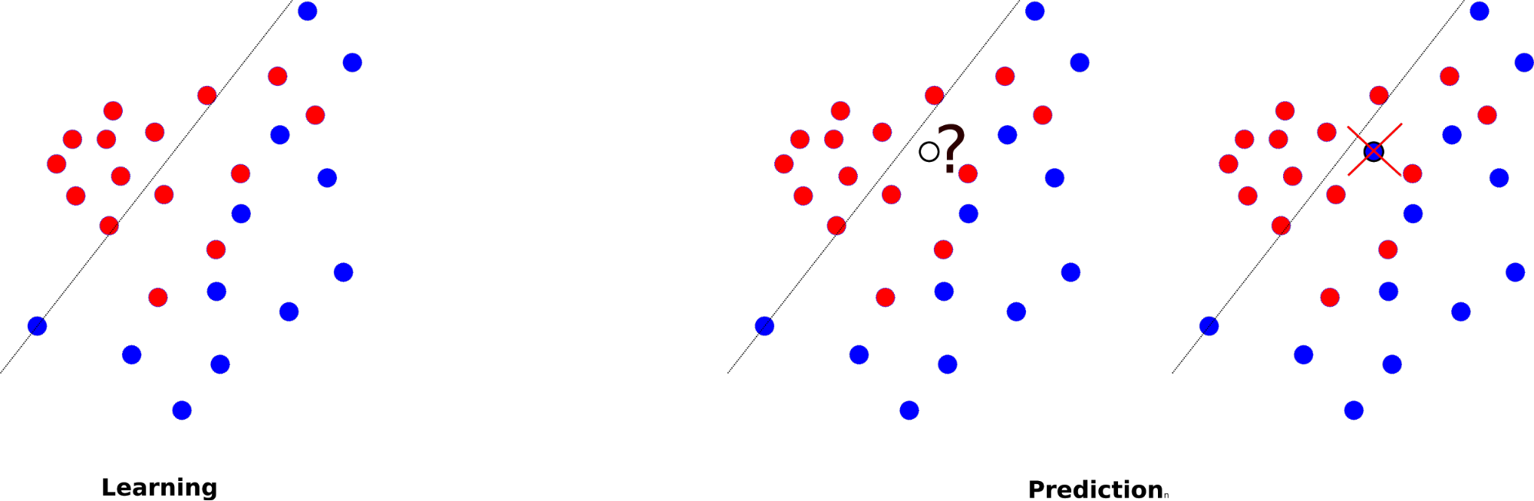
Bias(underfitting) vs. Variance(overfitting)

Slide 15
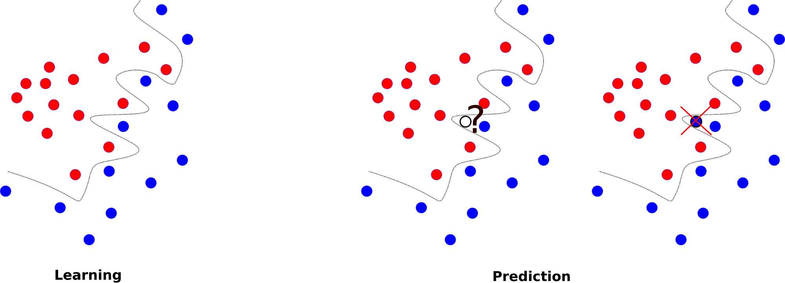
Overfitting

Slide 16
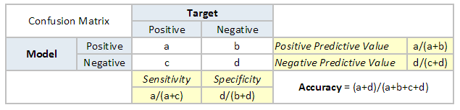
Step 4: Evaluating model performance

Slide 17
Step 4: Evaluating model performance
Confusion Matrix: Accuracy and Misclassification Rate
n=200 | Actual: YES | Actual: NO
Predicted: YES | TP=90 | FP=15(α) | Total P in the model: 105
Predicted: NO | FN=10(β) | TN=85 | Total N in the model: 95
 | Total P in the data: 100 | Total N in the data:100 | Accuracy
Accuracy: Overall, how often is the classifier correct?
(TP+TN)/total = (90+85)/200 = 0.875
Misclassification Rate: Overall, how often is it wrong?
(FP+FN)/total = (10+15)/200 = 0.125
equivalent to 1 minus Accuracy “error rate”
Type I error: FP(alpha)
Type II error: FN(beta)

Slide 18
Confusion Matrix: Sensitivity and Specificity
n=200 | Actual: YES | Actual: NO
Predicted: YES | TP=90 | FP=15(α)
Predicted: NO | FN=10(β) | TN=85
 | Total P in the data: 100 | Total N in the data:100
 | Sensitivity (Recall) | Specificity
Sensitivity: When it’s actually yes, how often is it correct?
TP/TP+FN=90/100=0.9
"Recall"
Specificity: When it's actually no, how often is it correct?
TN/FP+TN= 85/100 = 0.85

Slide 19
Confusion Matrix: Precision and recall
n=200 | Actual: YES | Actual: NO
Predicted: YES | TP=90 | FP=15(α) | Total P in the model: 105 | Precision(PPV: Positive Predictive Value)
Predicted: NO | FN=10(β) | TN=85 | Total N in the model: 95 | NPV: Negative Predictive Value
Precision: When it predicts yes, how often is it correct?
TP/(TP+FP)=90/(90+15)=0.857
Recall: the number of true positive over the total number of positives
TP/(TP+FN)=90/(90+10)=0.9

Slide 20
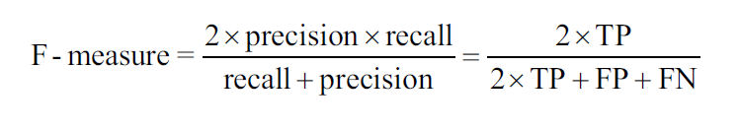
F measure/score
The F-score has been widely used in the natural language processing literature, such as the evaluation of named entity recognition and word segmentation.

Slide 21
Step 5: Improving model performance
Fine-tune the performance of machine learning models by searching for the optimal set of training conditions
Adjusting K for KNN, parameters for the training
Adjusting # of nodes and hidden layers
Combining models into groups that use teamwork to tackle the most challenging problems
Ensemble
Bagging, or bootstrap aggregating
AdaBoost, or adaptive boosting
Random forests

Slide 22
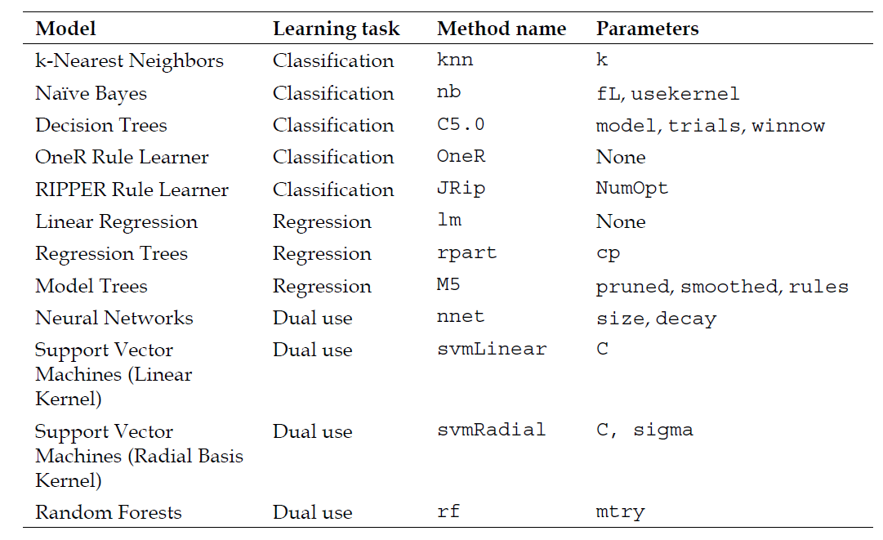
Tuning Parameters

